Slide 1

Movie Review
Sentiment Analysis
CSC 761-UT1 (Advanced Artificial Intelligence) – Project Presentation – Spring 2024
UNIVERSITY OF
SOUTH DAKOTA

Slide 2

Team Members -
SPRING 2024
CSC 761-UT1
-
Bheema Sai Shankar Reddy Sabilla
ID: 101179711
Bheema.sabilla@coyotes.usd.edu
-
Vamsi Sangana
ID: 101176712
Vamsi.sangana@coyotes.usd.edu

Slide 3


1. Motivation
-
Most convenient source of entertainment
-
Often confused about whether to watch that
particular movie or not
-
We check websites for ratings and reviews
-
Most of them show rating based on the stars
given
-
But no method to know about the success of
the movies based on the reviews and
comments

Slide 4
2. Introduction
-
To determine the success or failure based on
the reviews, we analyze the text
-
Interpret and classify the emotions within
textual data
-
Focuses on polarity - Positive reviews or
Negative reviews
-
We used 3 classiﬁers -
●
Logistic Regression
●
Naive Bayes
●
Support Vector Machine (SVM)

Slide 5
3. Dataset Info
-
The dataset can be found at -
IMDB Dataset of 50K Movie Reviews
-
Dataset provided by Kaggle
-
50,000 movie reviews from IMDB website
-
25K for training data & 25K for testing data

Slide 6
4. Data Preprocessing
-
Removing HTML tags
-
Remove special characters and stopwords
-
Lemmatization
-
Tokenization

Slide 7
5. Feature Extraction
-
Is used to convert feature (words in this case)
into some form.
Bag of Words Approach
●
Term Frequency
●
CountVectorizer with scikit-learn

Slide 8
6. Classiﬁcation Models
-
Classiﬁers -
●
Logistic Regression
●
Naive Bayes
●
Support Vector Machine (SVM)

Slide 9
A. Logistic Regression
-
Discriminative Model
-
Logistic Function (Mostly Sigmoid)
-
Pretty good for binary output model (positive or
negative)
-
Not good for non-linear solutions

Slide 10
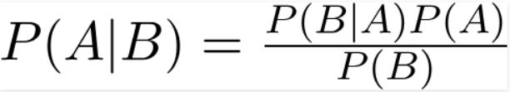
B. Naive Bayes
-
Generative Model
-
Assumes all features are conditionally
independent
-
Based on Bayes Theorem
-
May be absurd for real-life cases since
predictors are usually dependent.

Slide 11
C. Support Vector Machine (SVM)
-
Objective is to deﬁne hyperplane in
N-dimensional space to classify data points.
-
Goal is the maximizing margin (between two
data points)
-
Also good for non-linear solutions (Kernel trick)
-
Very suitable for text classiﬁcation

Slide 12
7. Result Evaluation
●
ACCURACY
●
A result evaluation measure
●
It is the ratio of correctly predicted
observations to the total number of
observations
●
Higher
the
accuracy
better
the
model

Slide 13
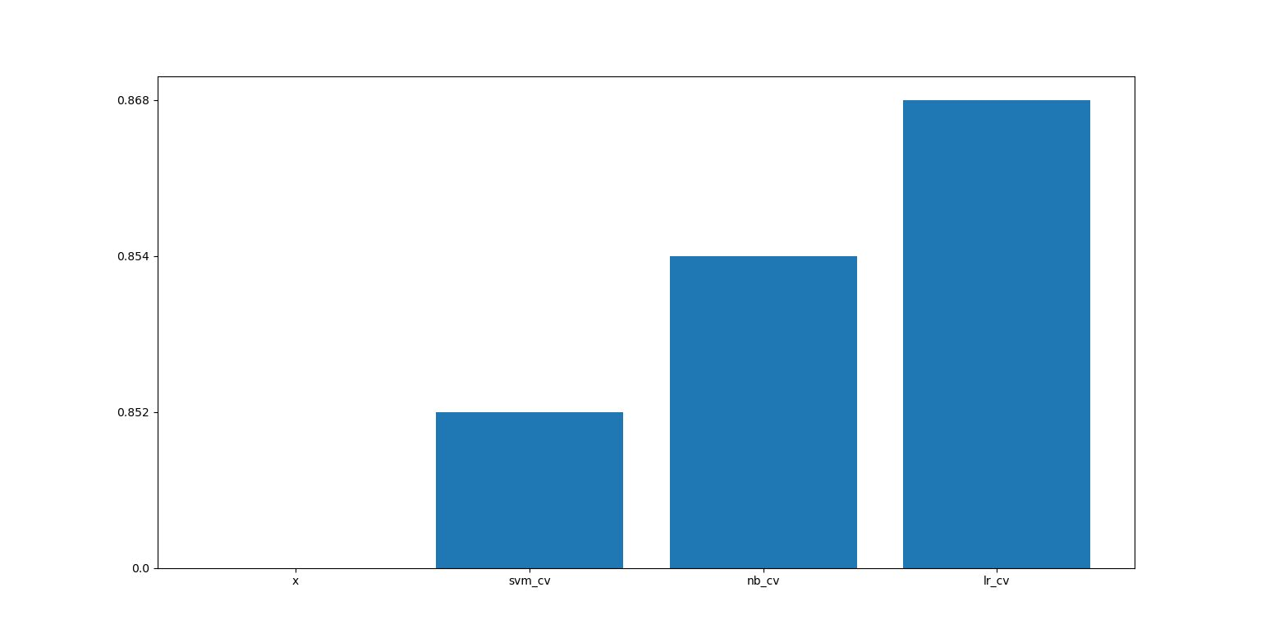
(cont.)
7. Result Evaluation
●
LOGISTIC REGRESSION
●
Accuracy: 86.89%
●
SUPPORT VECTOR MACHINE
●
Accuracy: 85.29%
●
NAIVE BAYES
●
Accuracy: 85.48%

Slide 14
8. Conclusion
-
Highest accuracy obtained on Logistic
Regression model.
-
LR performs better than Naive Bayes
-
LR outperforms the SVM, which is known to be
the best choice for textual data.

Slide 15
9. Our Learning
Before
handling
●
the
data
we
need
to
clean
the
data.
This
is
called
data
preprocessing. Necessary to clear missing, noisy and inconsistent data which
might aﬀect accuracy.
●
Sentiment Analysis is extraction of the emotions from within the textual data. It is a
technique based upon Natural Language Processing.
●
Logistic regression and support vector machines are closely linked. Both can be
viewed as taking a probabilistic model and minimizing some cost associated with
misclassiﬁcation based on the likelihood ratio.
●
Naive Bayes classiﬁer is the generative model. Naive Bayes also assumes that the
features are conditionally independent.
●
Both Naive Bayes and Logistic regression are linear classiﬁers, Logistic Regression
makes a prediction for the probability using a direct functional form whereas
Naive Bayes ﬁgures out how the data was generated given the results.
●
Thus, when the training size reaches inﬁnity then discriminative model logistic
regression performs better than the generative model Naive Bayes.
●
Hence in our project we get more accuracy for Logistic Regression than the other
two classiﬁers.
-
Bheema Sai Shankar Reddy Sabilla

Slide 16
9. Our Learning
●
Understood that main diﬃculty is to make dataset ready for training (Data
Preprocessing).
●
Understood
the
diﬀerences
between
generative
and
discriminative
models.
●
When dataset size is very large like inﬁnite discriminative models are
preferable. However, Generative models can reach its asymptotic faster
since it needs fewer training set to do that.
●
As known that SVM is the one the best classiﬁers. However, it performs
poorly
in
our
dataset.
Main
reason
of
this
may
be
we
have
ignored
hyperparameter tuning. If we consider hyperparameter tuning, accuracies
for SVM and LR may increase but Naive Bayes accuracy may remain stable.
-
Vamsi Sangana

Slide 17
9. Our Learning
●
Got to learn that, constructing and training a model is only a small part of a
machine learning project, major task lies in Data Pre-processing
●
Learned various ways to clean the textual data and why is it necessary, to
make it suitable to feed to our learning model.
●
Learned to apply what was taught in class in our project, like which models
to choose for a speciﬁc task, which in our case was text classiﬁcation.
●
Learned how to improve the accuracies of the models by employing
various optimization techniques like hyperparameter tuning
●
Learned the actual diﬀerence between probabilistic and Binary Classiﬁers
●
Got to know that, though some models are considered better for some
tasks, but other models can outperform them in some data-sets, which
happened in our case.

Slide 18
10. References
Kim S-M, Hovy E (2004) Determining the sentiment of opinions in: Proceedings of the 20th international conference on Computational Linguistics, page 1367. Association for Computational Linguistics, Stroudsburg, PA, USA.
Pang B, Lee L (2008) Opinion mining and sentiment analysis. Found Trends Inf Retr2(1-2): 1–135.

Slide 19
Thank You

